Slide 1
InControl R2 Contact Center Reports Overview
Running Reports

Slide 2
InControl Contact Center Reports
The following slides will walk you through the process of running an Agent Call Summary Report. Follow the same procedure for the other reports. It is suggested you run one of each report so you can see the data each provides.
If you are also licensed nonACD reports, they will also appear as options in the menu.

Slide 3
InControl Settings
Administration settings allow you to create nonACD departmental groups and add extensions to the groups.
Personal settings allow you to set default date and time settings.

Slide 4
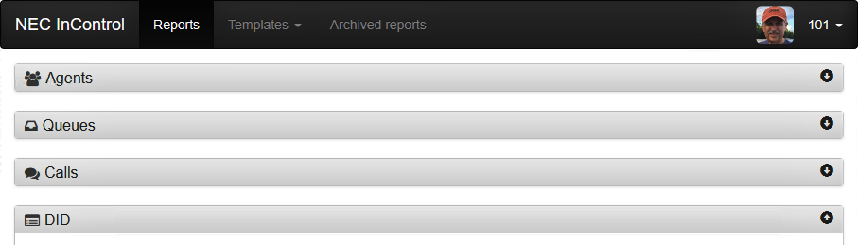
Contact Center Reports
Click on the report category you want to run
Then click on the report you want to run

Slide 5
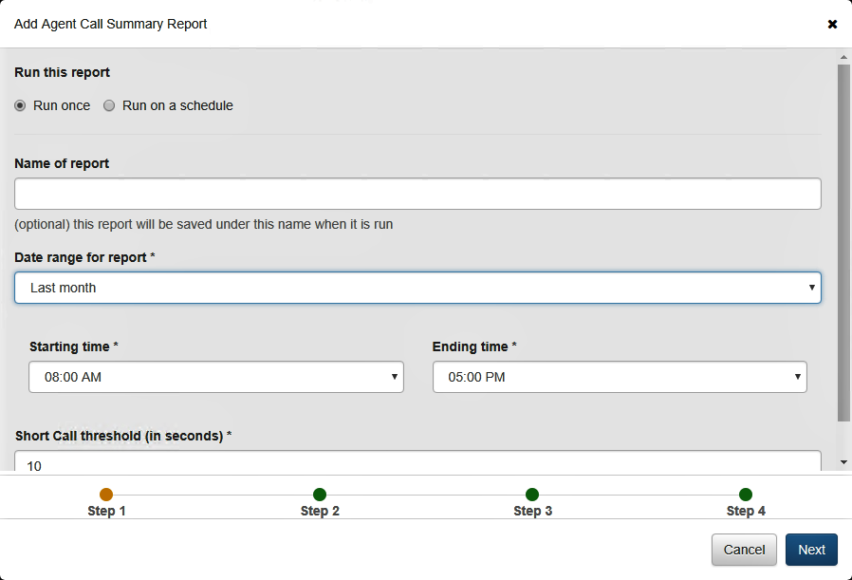
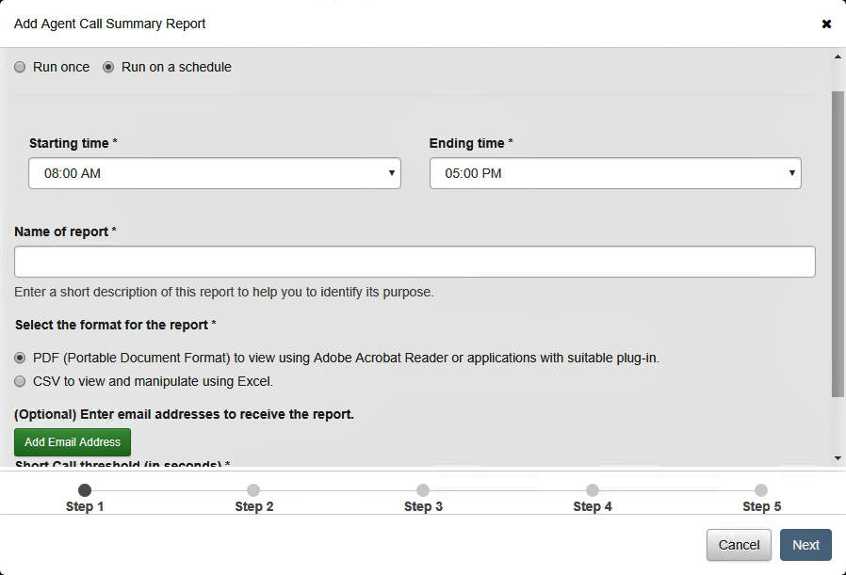
Run Once or on a Schedule?
If you give your report a name it will save the report as a template. Without a name, the report will run only once.
Pick your date range and Start/End times.
Choose PDF or CSV format.
Add an email address or download it from the archives.

Slide 6
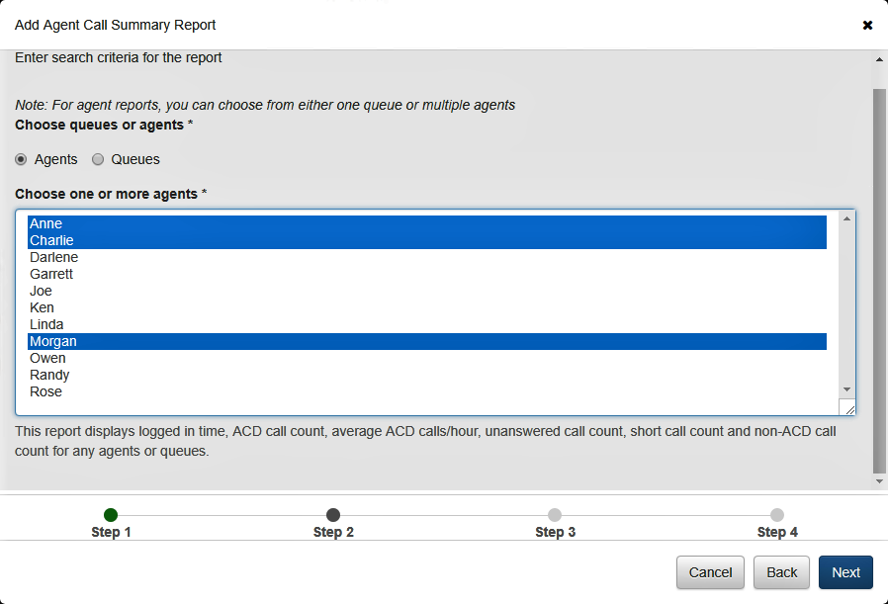
Selection Criteria
Control mouse click to choose multiple agents.

Slide 7
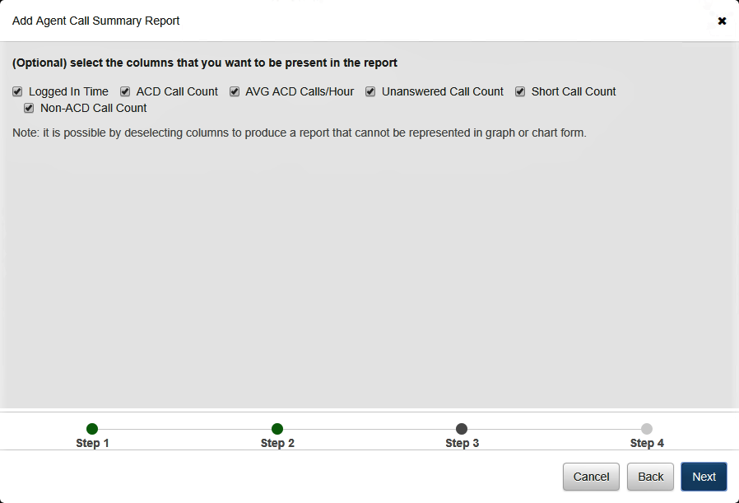
Data to be Included
Select/deselect the column data you want to include.
Note: This can be adjusted later on a live report.

Slide 8
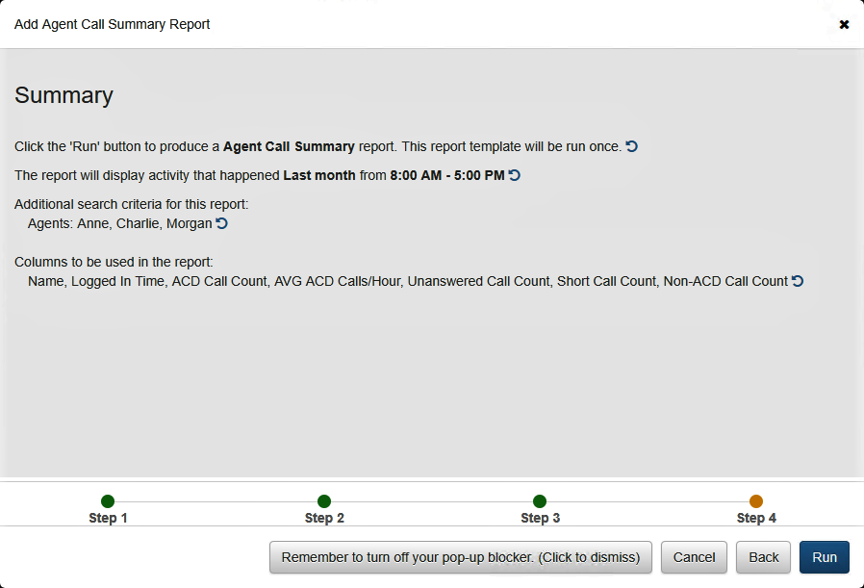
Summary of Report Criteria
Here is your chance to review and edit any settings. Click the blue arrow to go back to that selection box.
Don’t forget to check this browser setting or your report won’t run. Consult your browser help document for more information.

Slide 9
Sample Table Report

Slide 10
Modify a Table Report
Click here to print
Click the three horizontal lines to bring up additional options such as hiding columns or exporting the report as a CSV file

Slide 11
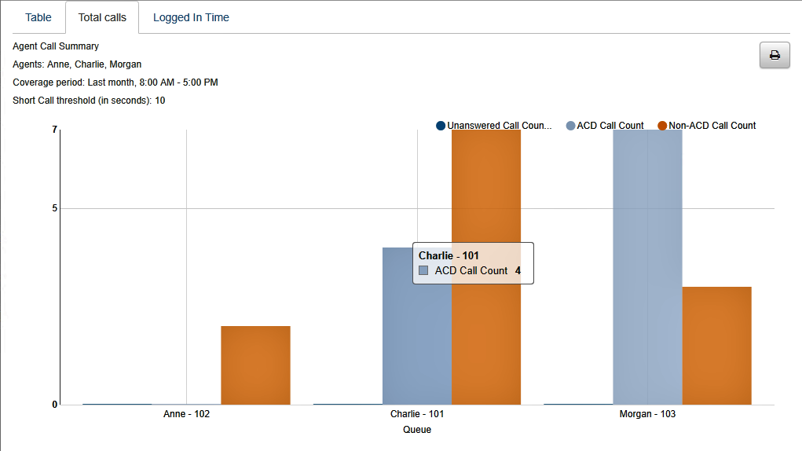
Sample Chart from the Same Report
Mouse over a column to get additional detail.

Slide 12
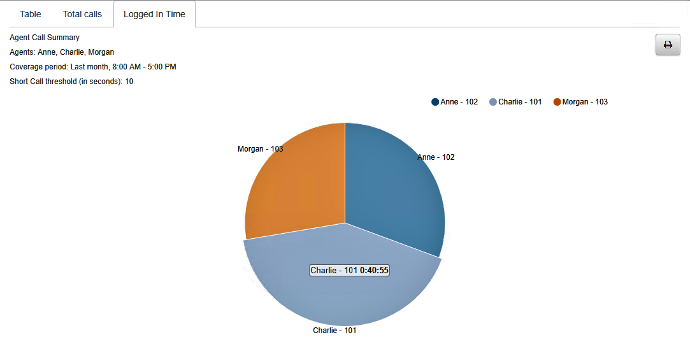
Sample Graph from the Same Report
Mouse over a pie section to get additional detail.

Slide 13
Thank You

