Slide 1
Contact Center R2
Dashboard
Overview
Setting up a Dashboard Display

Slide 2
Contact Center Dashboard
The following slides will walk you through the process of creating an Agent State Display. Follow the same procedure for the other displays. It is suggested you setup one of each display so you can see the data each provides.

Slide 3
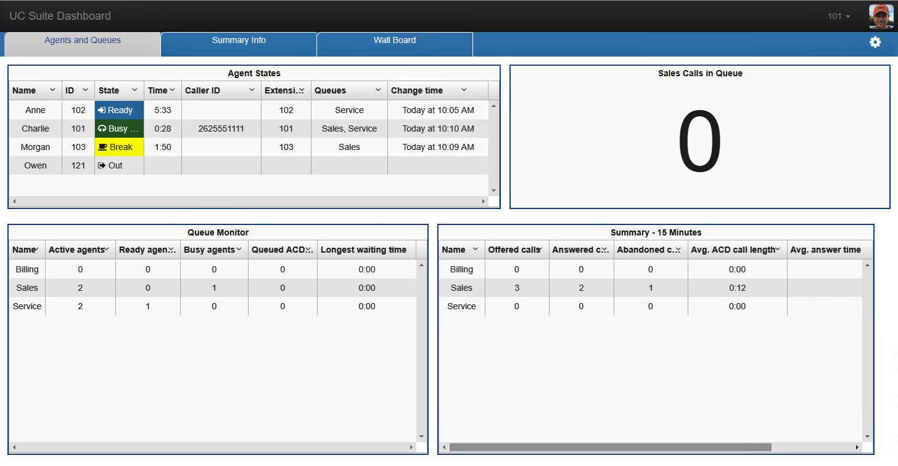
Sample Dashboard
Multiple tabs.
Multiple displays per tab.

Slide 4
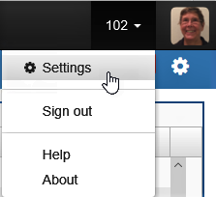
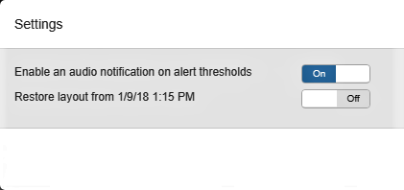
Dashboard Personal Settings
Access Settings by mouse clicking on your ID.
Settings allow you to toggle audio notifications and to restore a prior layout.
Audible alerts are great if you want to minimize your browser window and want to be notified of threshold changes

Slide 5
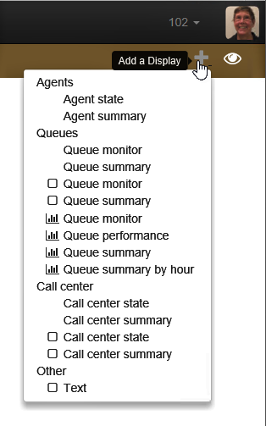
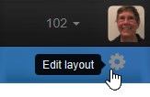

Adding a Display
Click on the Edit Layout icon.
Click on the Add A Display icon and choose the display you want to add.
Click on the Tab name to change it.

Slide 6
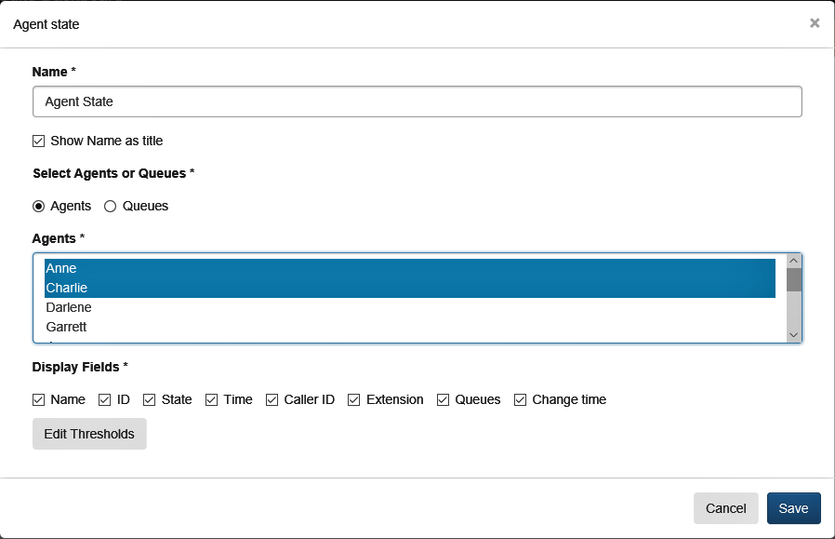
Select Criteria
Control click to select multiple Agents.
Click Edit Thresholds to enable visual and audible alerts.

Slide 7
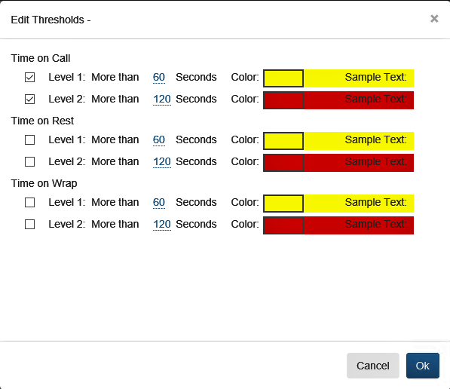
Edit Thresholds
Click to enable.
Click to adjust time thresholds.
Click to change color.

Slide 8
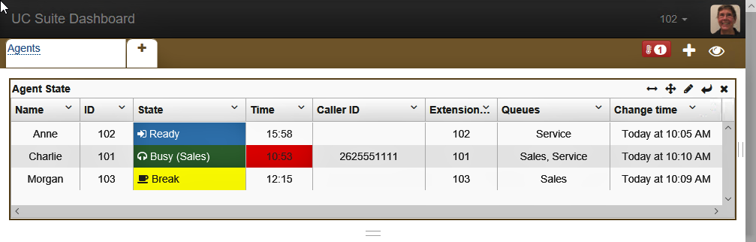
Modify Dashboard Location & Size
Control to move display to a new tab.
Control to move display to a new location.
Control to delete display.
Control to save display.
Control to resize display.
Control to edit display content.
Control to create a new row with this display on it.
Control to resize display.

Slide 9
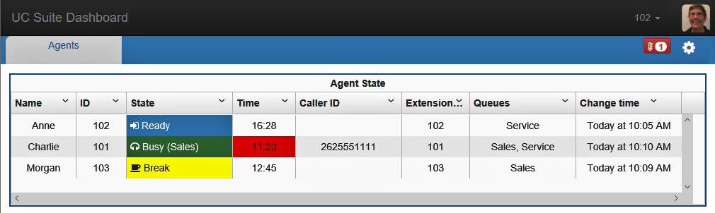
Finished Display

Slide 10
Thank You

